Slide 1
SLIRPI Automatic system
Kent Qian
2017/06/26

Slide 2
Flow Chart for Automatic System of SLIRPI

Slide 3
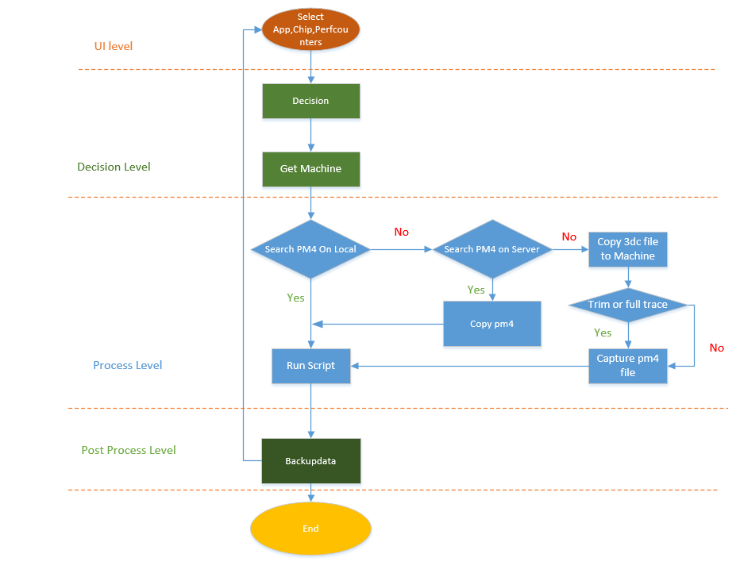

Slide 4
Detailed Chart for 3dc-counter Part

Slide 5
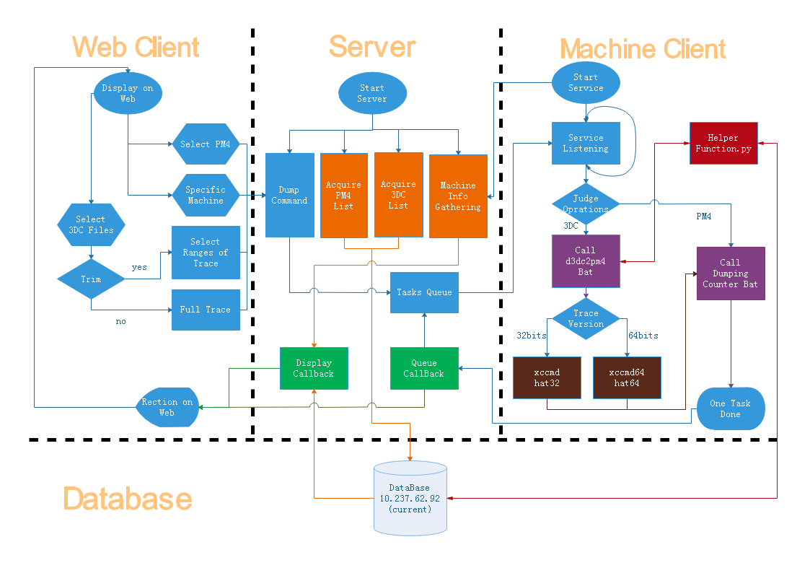

Slide 6
Additional Information
Chart head fields in Database
3dc_list
Pm4_list
hostname | d3dc_list | d3dc_path | d3dc_server_path
varchar(50)[PRI] | varchar(200)[PRI] | varchar(200) | varchar(200)
hostname | pm4_list | capture_date | pm4_path | pm4_server_path
varchar(50)[PRI] | varchar(200)[PRI] | varchar(20)[PRI] | varchar(200) | varchar(200)

Slide 7
Additional Information
Chart head fields in Database
Machine_list
Pm4_logs_status
hostname | os | cpu | gpu | eng_clk | mem_clk | driver_v | driver_date
varchar(50)[PRI] | varchar(20) | varchar(100) | varchar(100) | varchar(50) | varchar(50) | varchar(50) | varchar(20)
pm4_list | os | cpu | gpu | eng_clk | mem_clk | driver_v | driver_date
varchar(200)[PRI] | varchar(20) | varchar(100) | varchar(100) | varchar(50) | varchar(50) | varchar(50) | varchar(20)

Slide 8
Disclaimer & Attribution
The information presented in this document is for informational purposes only and may contain technical inaccuracies, omissions and typographical errors.
The information contained herein is subject to change and may be rendered inaccurate for many reasons, including but not limited to product and roadmap changes, component and motherboard version changes, new model and/or product releases, product differences between differing manufacturers, software changes, BIOS flashes, firmware upgrades, or the like. AMD assumes no obligation to update or otherwise correct or revise this information. However, AMD reserves the right to revise this information and to make changes from time to time to the content hereof without obligation of AMD to notify any person of such revisions or changes.
AMD MAKES NO REPRESENTATIONS OR WARRANTIES WITH RESPECT TO THE CONTENTS HEREOF AND ASSUMES NO RESPONSIBILITY FOR ANY INACCURACIES, ERRORS OR OMISSIONS THAT MAY APPEAR IN THIS INFORMATION.
AMD SPECIFICALLY DISCLAIMS ANY IMPLIED WARRANTIES OF MERCHANTABILITY OR FITNESS FOR ANY PARTICULAR PURPOSE. IN NO EVENT WILL AMD BE LIABLE TO ANY PERSON FOR ANY DIRECT, INDIRECT, SPECIAL OR OTHER CONSEQUENTIAL DAMAGES ARISING FROM THE USE OF ANY INFORMATION CONTAINED HEREIN, EVEN IF AMD IS EXPRESSLY ADVISED OF THE POSSIBILITY OF SUCH DAMAGES.
ATTRIBUTION
© 2013 Advanced Micro Devices, Inc. All rights reserved. AMD, the AMD Arrow logo and combinations thereof are trademarks of Advanced Micro Devices, Inc. in the United States and/or other jurisdictions. Other names are for informational purposes only and may be trademarks of their respective owners.

